Slide 1
Introduce of B1 DB Compare

Slide 2
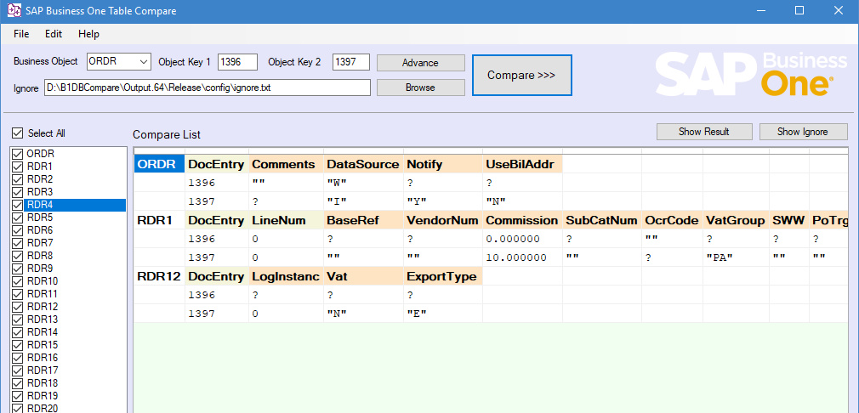

Slide 3
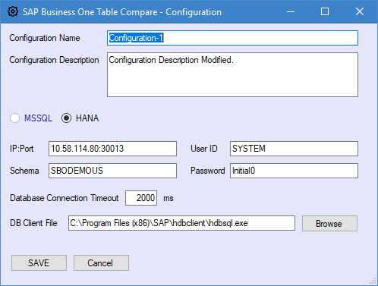
Database Configuration
You can save this configuration for next boot up.

Slide 4
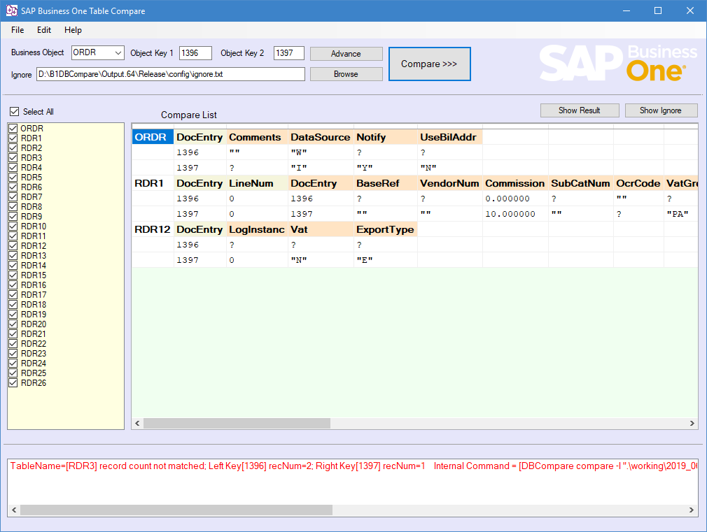
Use friendly
Enable Select Business Objects main table and its sub tables.
Compare result can use ignore file to ignore automatically.
Error info could display to show you the other difference between to records.

Slide 5

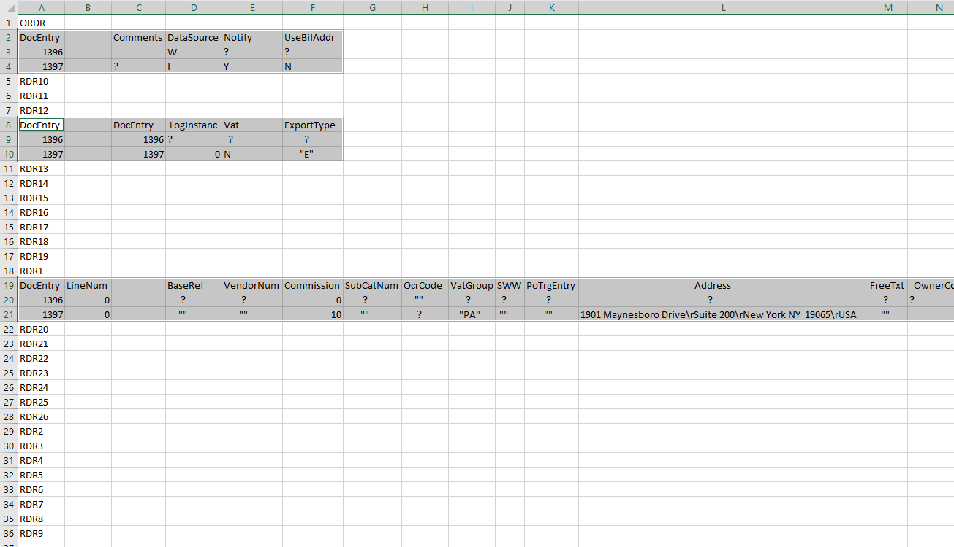
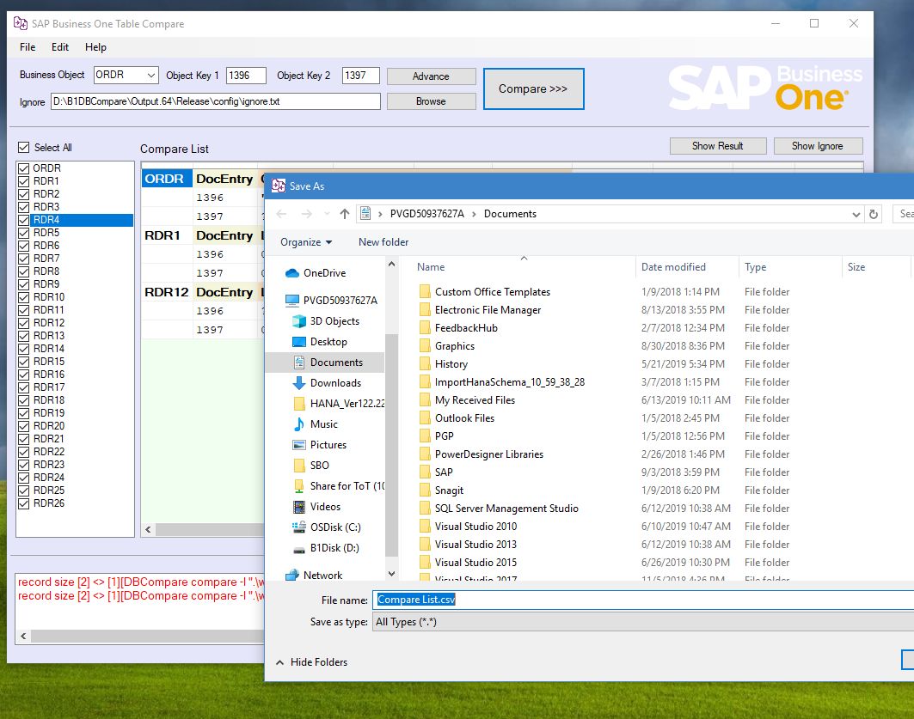
Save result
You can save the result with csv format.

Slide 6
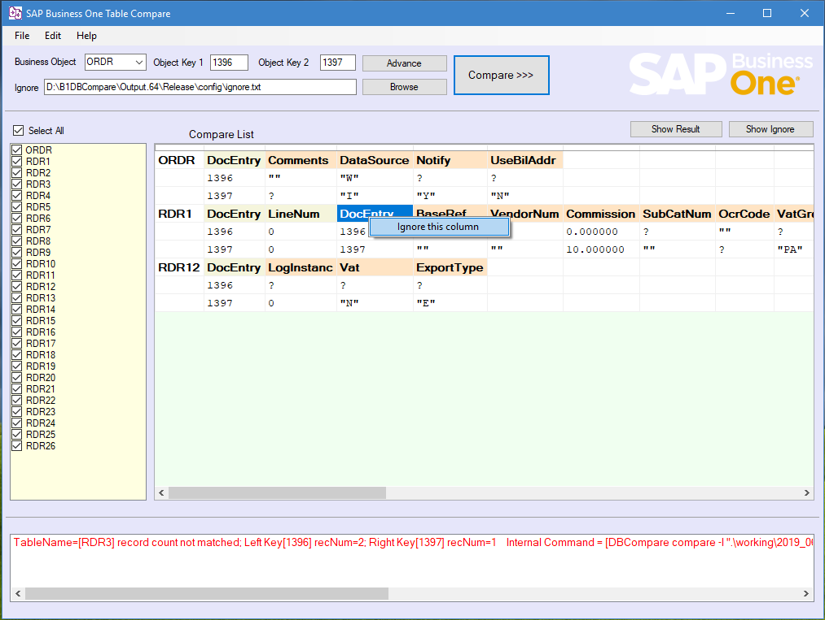
Ignore Column intuitively
Ignore one Column and the value will be saved to Ignore.txt files .
The display table will refresh automatically.

Slide 7
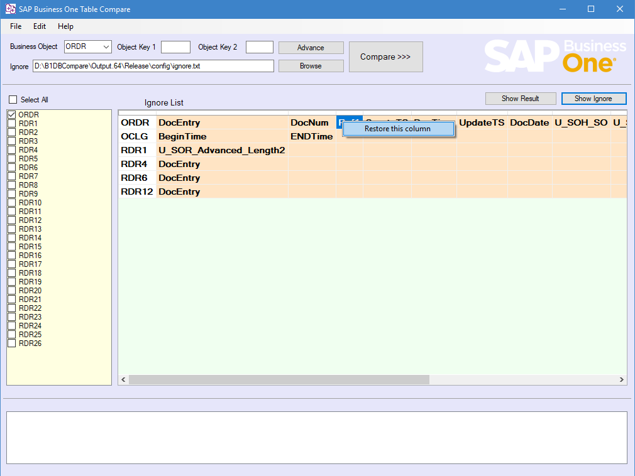
Restore Column intuitively
Also you can restore the column you want.

Slide 8
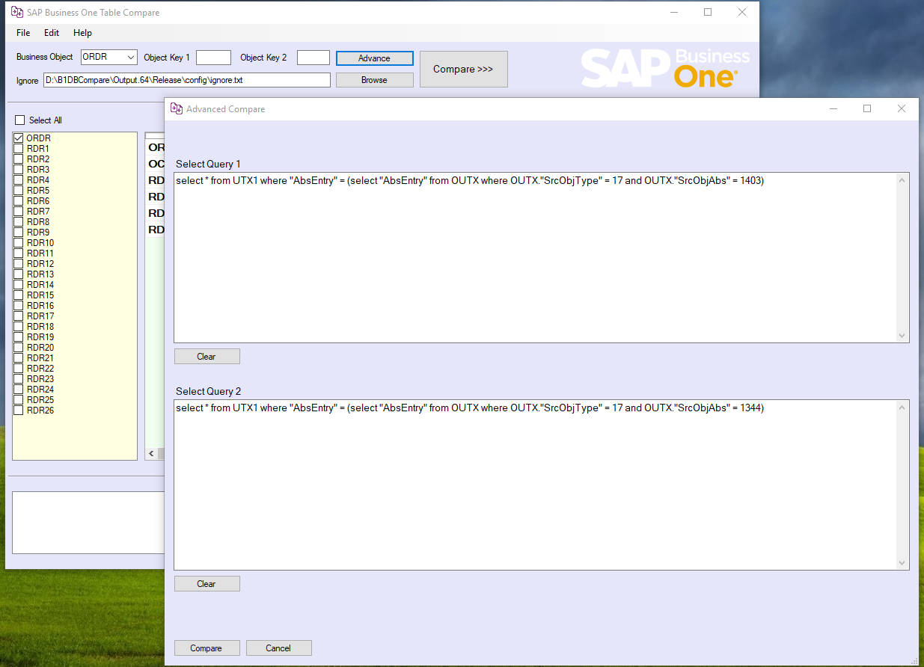
Advanced Query Compare
If current Business Objects are not suitable, you can use Advanced form for comparing manually.
But you must keep record size to be the same. Otherwise it will report error.

Slide 9
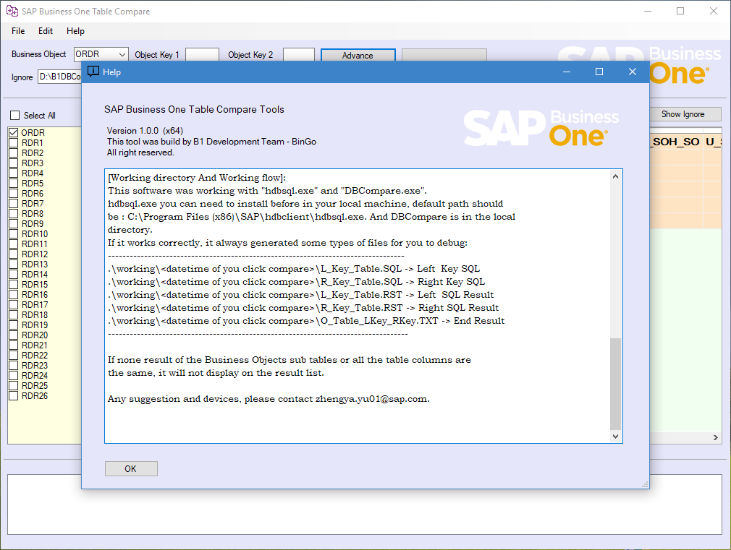
Help document
If its unclear for using, you can also you help form for more details.

